Slide 1

SUPER CUBE
Group ONE’s final project

Slide 2
Team : CUBE BOYS
Li Jiankuan
Li Yueheng
He Zitong
You Xiangyu

Slide 3
Requirements
1. Scenes: at least 3 scenes
a. Being flesh Scene
b. 6 Game levels (Scenes)
c. Win/lost Scenes
2. Game complexity: in terms of objects
a. At least three different types of game objects (different behaviors)
b. At least 10 game instances of objects in the scene (any combination of the three game object types)
c. At least one inter object collision being clearly per-pixel accurate
3. At least 2 camera views
4. Behavior: per- or inter-object interaction
a. Feature the use of chase or rotate away, or any types of pseudo autonomous behavior

Slide 4
Requirements
5. Game world:
a. Lights:
i. At least two total lights where at least one light source from each type: at least one point, one directional, and one spotlight
ii. At least one of the light sources must have parameters that are animated (e.g., color changing, or position, or direction, etc.)
b. Normal Map:
i. At least one object type must clearly show the use of NormalMap

Slide 5
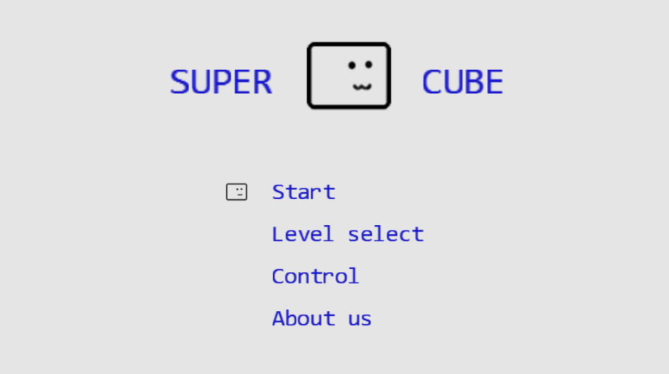
Start Scene

Slide 6
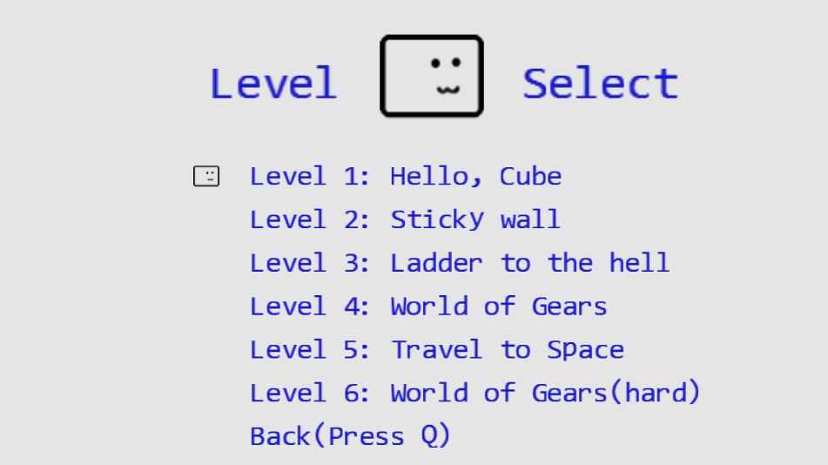
Level select

Slide 7
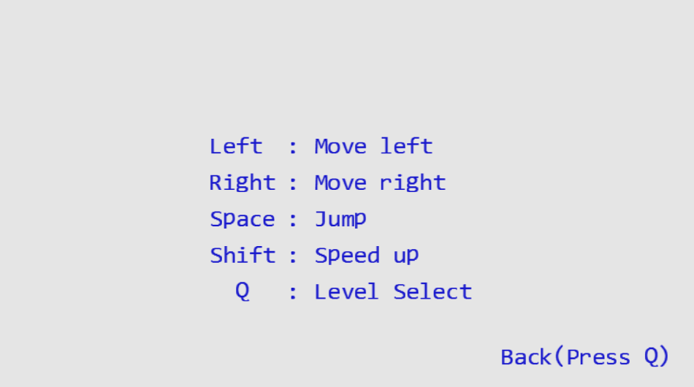
control

Slide 8
Characteristic 1
SIMPLE BUT LOVELY
EASY TO CONTROL
INTERESTING
CHALLENGING
EXTENDIBILITY AND POTENTIAL

Slide 9
Characteristic 1
SIMPLE BUT LOVELY
EASY TO CONTROL
INTERESTING
CHALLENGING
EXTENDIBILITY AND POTENTIAL

Slide 10
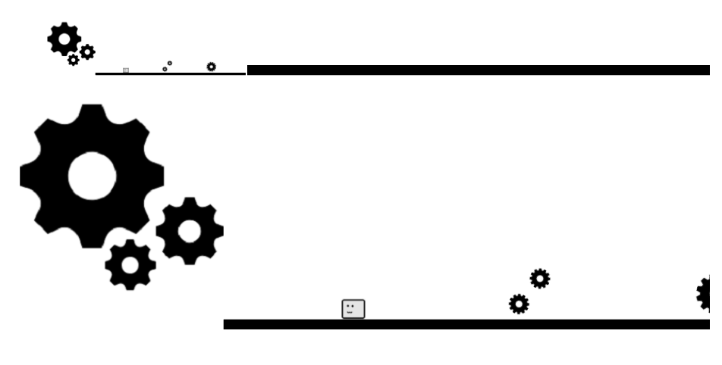
Characteristic 2
LITTLE MAP : Help you advance

Slide 11
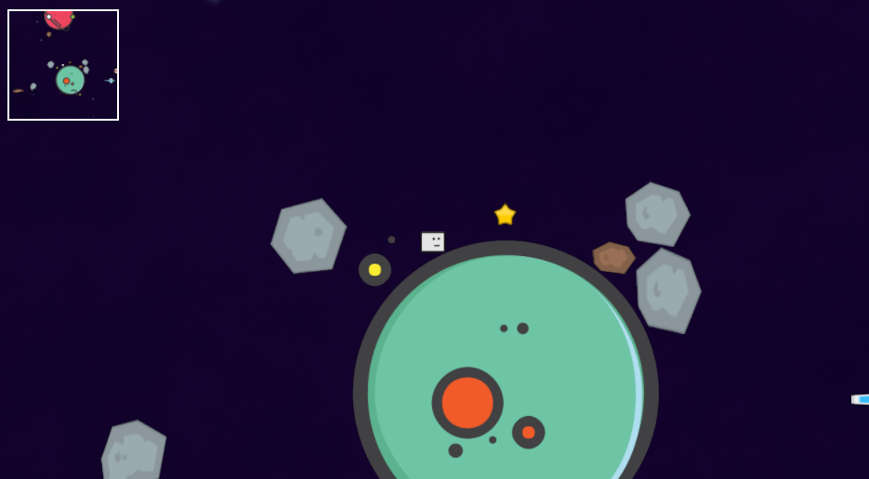
Characteristic 3
ResourceMap：To save the game in progress.

Slide 12
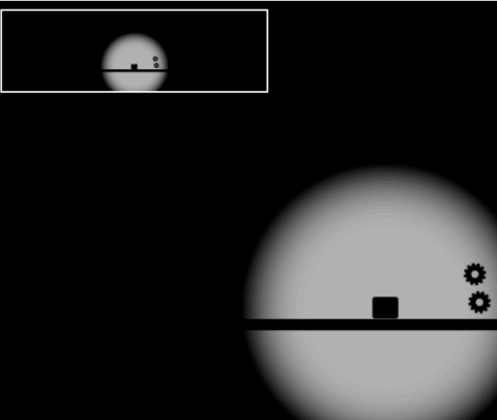
Characteristic 4
HELL DIFFICULTY: In a dark night

Slide 13
Characteristic 5
NO BGM…

Slide 14
MORE?
MORE LEVELS MORE THEMES
MORE OBSTACLES MORE BEHAVIORS
MORE FUN MORE CHALLENGES

